Slide 1

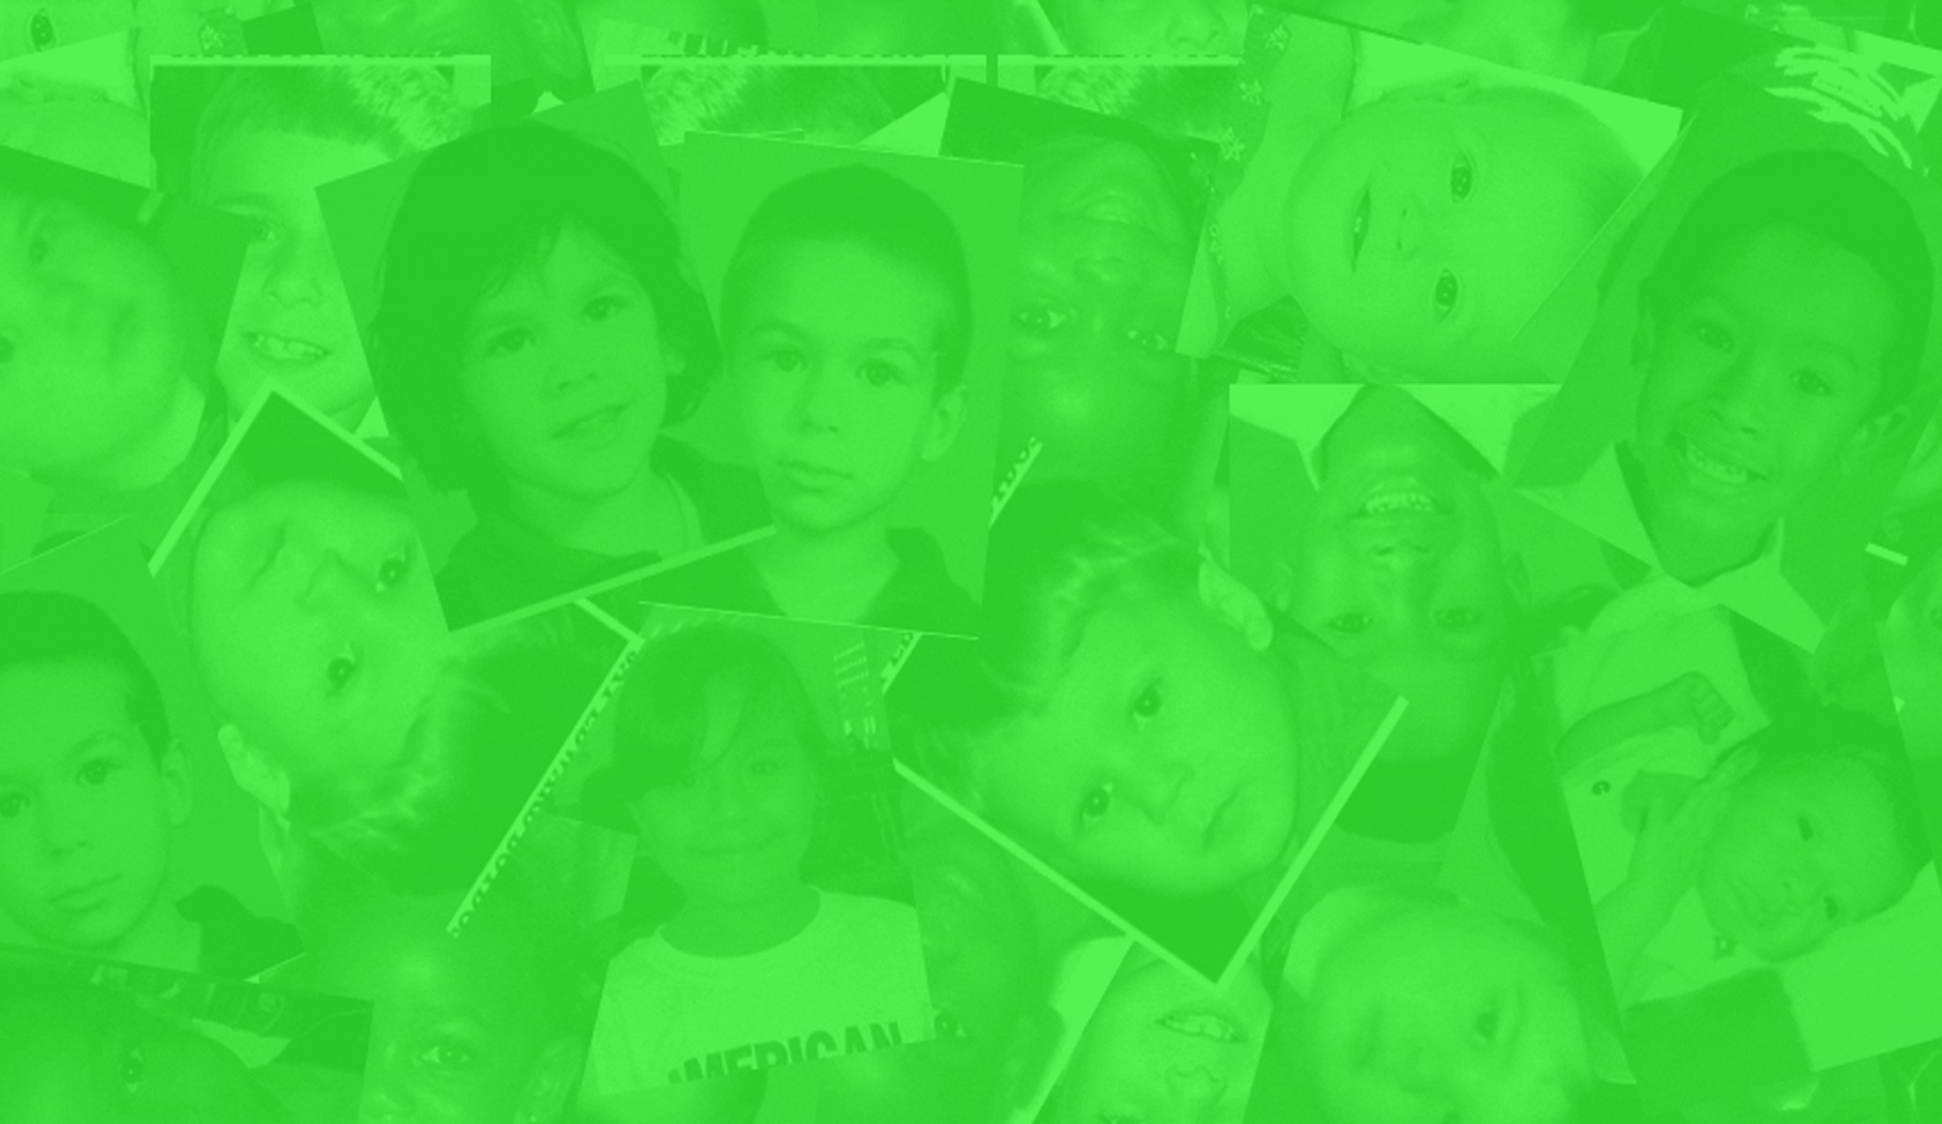


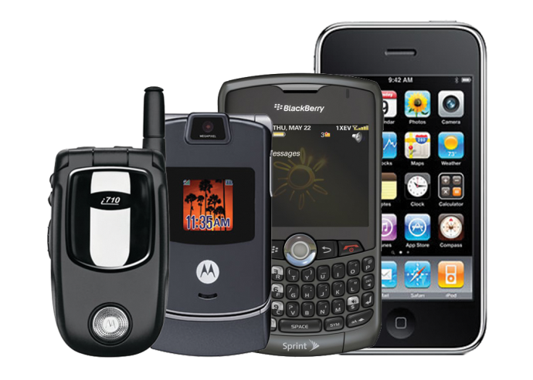
&
A PARTNER PROGRAM TO HELP AAFLC
Prepared for | Company Name
Contact Name
MYCELLFUNDS.COM | 866.874.6759

Slide 2






CELL FUNDS
REDUCE, REUSE, & RECYCLE TO HELP A CHILD
Cell Funds is an E-waste recycler that has offered our services since 2005. We recycle and refurbish cell phones in an environmentally safe manner.
Cell Funds provides individuals and organizations with the opportunity to earn cash for their recycling efforts.
We pay the maximum allowable recovery value for cell phones, tablets, iPads, laptops, PSP’s, Gameboys, and GPS units. Cell Funds utilizes only EPA certified recycling facilities and vendors.
Our company has been partnered with AAFLC since 2011. We are a proud partner that is excited to see our program help a cause that is much in need.
Cell Phones
iPads’ & Tablets’
Laptops
PSPs’ & Gameboys’
GPS Units
E-Waste Recycler
MYCELLFUNDS.COM | 866.874.6759
14429 Ventura Blvd Ste. 108 Sherman Oaks, CA 91423
1
of
6

Slide 3
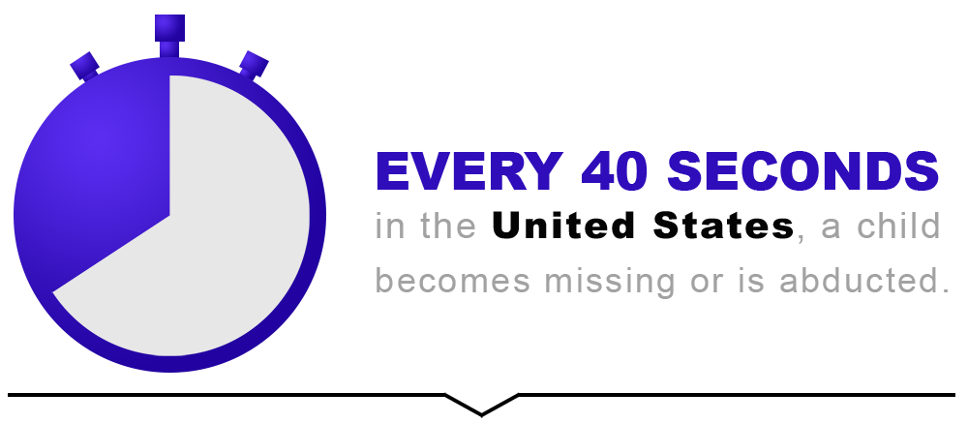
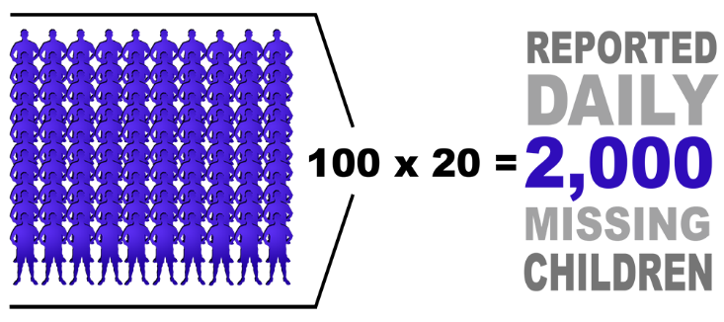
AAFLC.ORG
OVER 135 MISSING CHILDREN FOUND
MISSION STATEMENT
American Association For Lost Children (AAFLC) is an awesome and unique charity that physically finds and rescues missing children, operating on tax-deductible donations. AAFLC spends hours, days, weeks, and months conducting hands-on investigations, while traveling in and outside the country performing surveillance and undercover work searching for and rescuing missing children.
Since their beginning, AAFLC has found and rescued over 135 missing children from places like Germany, Lebanon, South Korea, Mexico and numerous cities within the United States. These missing children have endured physical, mental and emotional abuse – and in some cases sexual abuse. They need our help.
MYCELLFUNDS.COM | 866.874.6759
14429 Ventura Blvd Ste. 108 Sherman Oaks, CA 91423
2
of
6

Slide 4
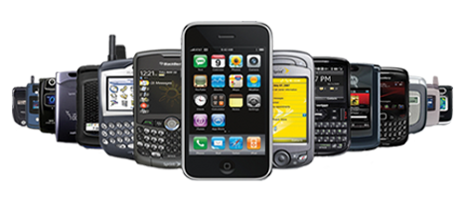

DONATE CELL PHONES
Cell Funds will recycle any old, used, new, working, broken or defective cell phones you may have laying around collecting dust. We donate proceeds from your cell phone donation to American Association for Lost Children.
TYPES OF DONATIONS
& COLLECTIONS
COMPANY CELL PHONES
PERSONAL EMPLOYEE CELL PHONES
COMMUNITY COLLECTION OUTREACH
COLLECTION CAMPAIGNS
FREE SHIPPING LABELS
DETAILED RECORDS
Short term & long term collection campaigns available. Cell Funds offers online marketing materials, such as flyers, email templates, collection boxes, press releases & PSA’s.
Cell Funds provides free shipping labels to anyone that needs to recycle 10 or more cell phones. A free FedEx pickup will be scheduled to assist you in mailing in recyclables.
Cell Funds keeps all detailed records for 7 years. We provide tax deduction documentation for all your donations. AAFLC is a registered 501c3 non profit organization.
MYCELLFUNDS.COM | 866.874.6759
14429 Ventura Blvd Ste. 108 Sherman Oaks, CA 91423
3
of
6

Slide 5


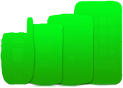












LOGISTICS
RECYCLING CAMPAIGN
WE PROVIDE
YOU PROVIDE
RECYCLING CAMPAIGN
2. CELL PHONE DRIVE
INTERNAL COLLECTION
Company Cell Phones
Employee Personal Cell Phones
2. EXTERNAL COLLECTION
Community Recycling Campaign
Distribution of Promo Material
3. EMAIL CAMPAIGN
Internal & External Campaign
HTML Email Blast
3. EMAIL HTML CAMPAIGN
4. PROMO MATERIALS
4. PROMO MATERIAL CAMPAIGN
Internal & External Marketing Campaign
Promo Materials Provided
5. A DEDICATED PROJECT MANAGER
MYCELLFUNDS.COM | 866.874.6759
14429 Ventura Blvd Ste. 108 Sherman Oaks, CA 91423
4
of
6

Slide 6





CELL FUNDS RECYCLING PROCEDURE
2A
CONDITION: Refurbish
Unit is fully functional under test, or the unit is cost-effective to repair. Repairs (including cosmetic) are completed. .
** Any data left on unit is destroyed or flashed with software.
2B
CONDITION: Recycle Only
Unit is not cost-effective to repair, or has no value on the secondary market.
1. SHIPMENT ARRIVES
New shipments are sorted, logged and inspected for condition
All shipments will receive a processing report log sheet, detailing the condition, amount and price of units received.
3B
PACKAGE FOR BULK SHIPMENT
Recycle Only handsets are packaged in bulk for shipment to recycling facility. Standard shipment is 1 ton, or approximately 10,000 handsets.
3A
PACKAGE FOR RESALE
Refurbished handsets are re-sorted based on current market demand, and packaged for shipment.
4B
RECYCLING FACILITY
Cell Funds ships Recycle Only units to EPA certified facilities HERE IN THE UNITED STATES.
NO foreign facilities used.
NO units are sent to landfills.
4A
REDUCE, REUSE, RE-SALE
All refurbished units ready for re-sale will be sold to the retail market, and to wholesale vendors in our Cell Funds database.
MYCELLFUNDS.COM | 866.874.6759
14429 Ventura Blvd Ste. 108 Sherman Oaks, CA 91423
5
of
6

Slide 7

CONTACT ME
BE A HERO, RECYCLE!
THANK YOU.
14429 Ventura Blvd Ste. 108 Sherman Oaks, CA 91423
Reduce, Reuse, Recycle
p. 866.874.6759
Agent Name
email@mycellfunds.com
Twitter
@cellfunds
Facebook
mycellfunds
Website
www.mycellfunds.com
MYCELLFUNDS.COM | 866.874.6759
14429 Ventura Blvd Ste. 108 Sherman Oaks, CA 91423
6
of
6

